Slide 1
Welcome!
2024 Knauss Marine Policy Fellowship
Informational Webinar

Slide 2
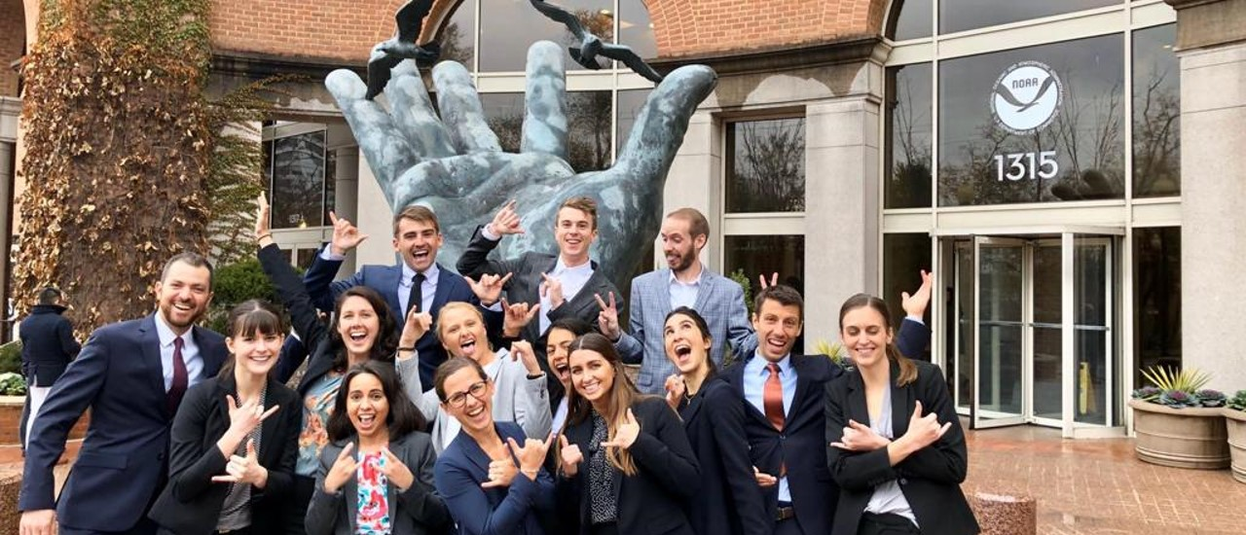
Knauss Fellowship Application Process at Maryland Sea Grant
Jim LaChance

Slide 3
What is the Knauss Fellowship?
An opportunity for graduate students interested in ocean, coastal, and
Great Lakes science to spend a year working in Washington, DC region
  Fellows are placed in a wide range of “host” offices
    Legislative & executive branch placements
    Legislative Fellowship
  $68,000 for stipend and personnel expenses
  Travel and professional development funds
  Opportunities for professional development
Knauss Marine Policy Fellowship
Maryland Sea Grant and the National Sea Grant College Program champion diversity, equity, and inclusion and encourage diverse applicants!
Notes:
https://www.mdsg.umd.edu/topics/graduate-fellowships/knauss-marine-policy-fellowships

Slide 4
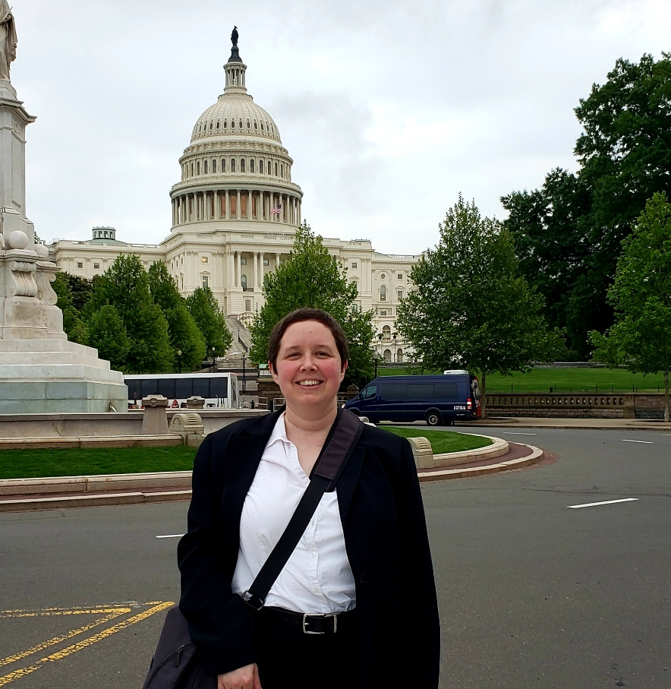
When does the fellowship take place?
February 1, 2024 – January 31, 2025
Applications are due to
Maryland Sea Grant
February 16, 2023 at 5 pm EST
Photo Credit: Zoraida Perez-Delgado/Maureen Brooks
Notes:
Mike - https://calendar.google.com/calendar/u/0/appointments/schedules/AcZssZ2MwBbaRZjiFAFbFI_jX34ets-3qwOmeLfWilepBebuP9nXFv43wZji7grzAbzoVS1j7lPNJ37D
Jim - https://jimlachance.youcanbook.me/

Slide 5
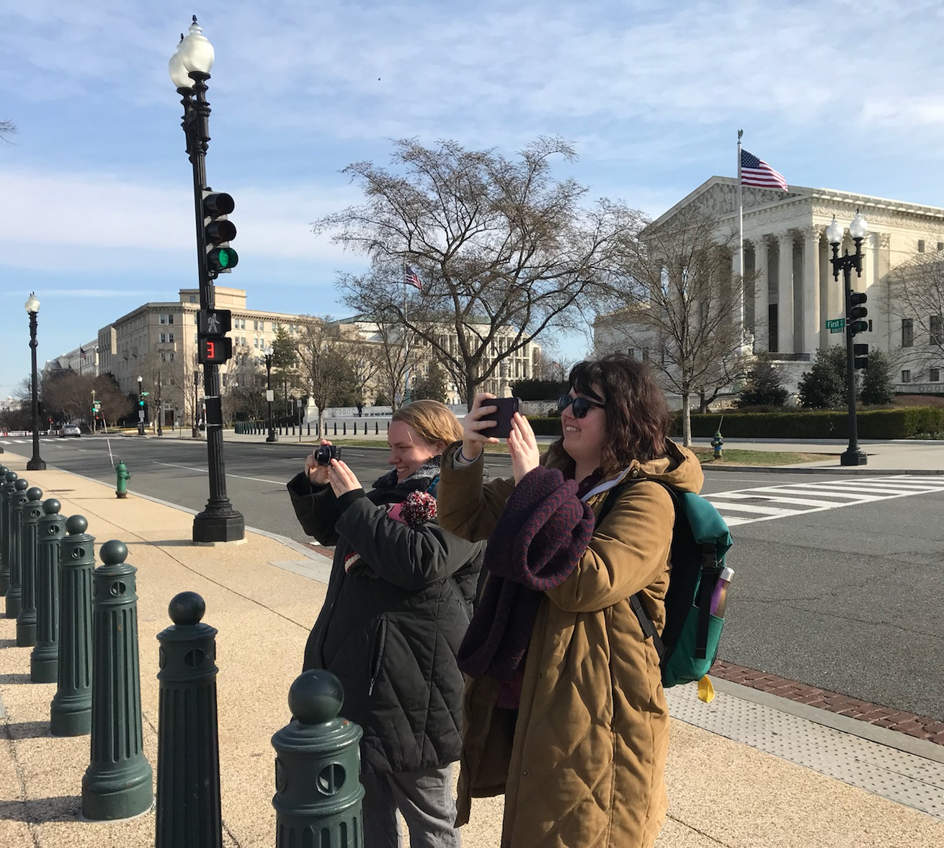
What’s the application process like?
Eligibility
  Enrolled in graduate degree program
  any time between Fall 2022 and
  February 16, 2023
  Accredited institution in Maryland
  Interest in ocean, coastal, and Great Lakes resources and policy
  International students are welcome!
  Information for Knauss Applicants
Photo Credit: Janet Hsiao/Noelle Olsen
Notes:
https://www.mdsg.umd.edu/information-knauss-applicants

Slide 6
Application process: MDSG virtual meeting
Applicants are strongly encouraged to meet with MDSG before the application due date to:
  Review the application process
  Discuss your draft application materials
  Answer any questions regarding the fellowship and/or application process
Reminder: please submit draft application materials one week ahead of
your virtual meeting
Mike Appointment Jim Appointment
Revise and resubmit in eSeaGrant by February 16, 2023 at 5pm

Slide 7
A closer look at the application materials
There are 5 required pieces for the application
  Curriculum vitae (2-page maximum)
  3 Short answers about your educational background and career path
  (1,500 words maximum)
  Relevant Coursework and Future Year Plans (1-page maximum)
  Two letters of recommendation
  Scanned copies of transcripts (official and unofficial are both accepted)
  How to Apply
Notes:
https://www.mdsg.umd.edu/information-knauss-applicants

Slide 8
A closer look at the application materials
There are 5 required pieces for the application
  Curriculum vitae (2-page maximum)
  3 Short answers about your educational background and career path
  (1,500 words maximum)
  Relevant Coursework and Future Year Plans (1-page maximum)
  Two letters of recommendation
  Scanned copies of transcripts (official and unofficial are both accepted)
  How to Apply
Notes:
https://www.mdsg.umd.edu/information-knauss-applicants

Slide 9
A closer look at the application materials
There are 5 required pieces for the application
  Curriculum vitae (2-page maximum)
  3 Short answers about your educational background and career path
  (1,500 words maximum)
  Relevant Coursework and Future Year Plans (1-page maximum)
  Two letters of recommendation
  Scanned copies of transcripts (official and unofficial are both accepted)
  How to Apply
Notes:
https://www.mdsg.umd.edu/information-knauss-applicants

Slide 10
A closer look at the application materials
There are 5 required pieces for the application
  Curriculum vitae (2-page maximum)
  3 Short answers about your educational background and career path
  (1,500 words maximum)
  Relevant Coursework and Future Year Plans (1-page maximum)
  Two letters of recommendation
  Scanned copies of transcripts (official and unofficial are both accepted)
  How to Apply
Notes:
https://www.mdsg.umd.edu/information-knauss-applicants

Slide 11
A closer look at the application materials
There are 5 required pieces for the application
  Curriculum vitae (2-page maximum)
  3 Short answers about your educational background and career path
  (1,500 words maximum)
  Relevant Coursework and Future Year Plans (1-page maximum)
  Two letters of recommendation
  Scanned copies of transcripts (official and unofficial are both accepted)
  How to Apply
Notes:
https://www.mdsg.umd.edu/information-knauss-applicants

Slide 12
How your application is evaluated
General evaluation points breakdown
  CV (10 points)
  Personal education and career development statements (55 points)
  Relevant coursework and future year plans (10 points)
  Letters of recommendation (5 points each)
Key Point: Regardless of point value, all parts of the application are opportunities for you to share your story and tell reviewers why the fellowship is a great fit for you!
Prospective Fellows
2024 Knauss Fellowship Student Guide
Notes:
https://seagrant.noaa.gov/insideseagrant/Knauss-Fellowship/Prospective-Fellows
Evaluation is done on a 100 point scale. If you want to look at specific values and a more detailed breakdown click the link.
Basically, 75 points are for the CV short answers and your academic experience. 15 points come from the recommendation letters. The final 10 are for overall application cohesions.
Note that all aspects of this application are opportunities for you to make a case for why you need and deserve this opportunity.

Slide 13
Timeline post-application submission
March 2023
May 2023
June 2023
Fall/
Winter 2023
Feb 2024
MDSG review panel evaluates applications and selects MD finalists
National competition review takes place
Maryland notifies all applicants of
the national competition outcome
Interview
with potential
host offices
Fellowship begins
Maryland finalists meet with
Dr. Fredrika Moser
All applicants are notified of their application status

Slide 14
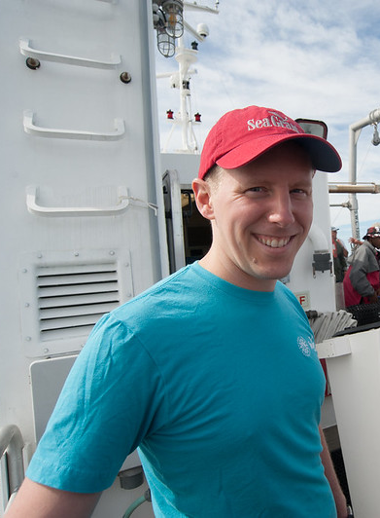
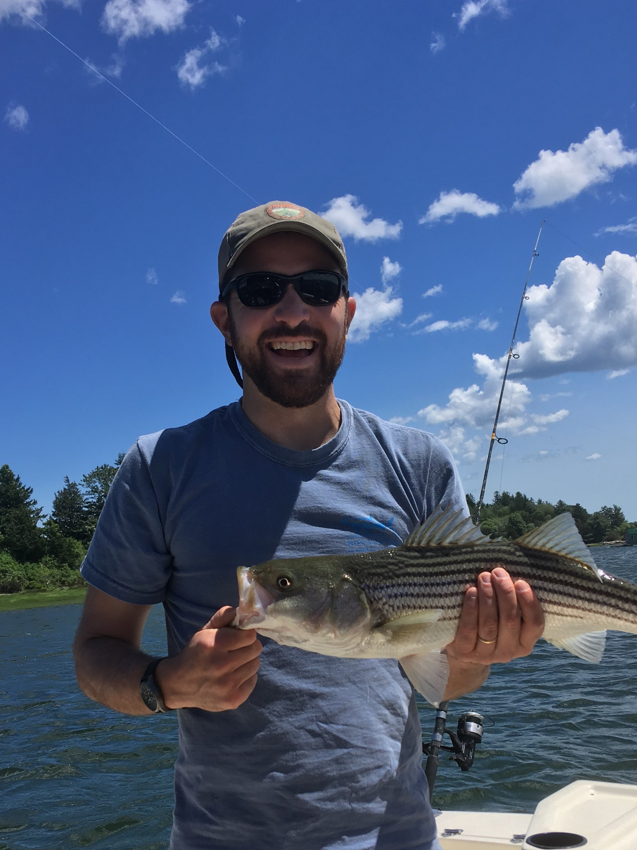
Questions?
Mike Allen
mallen@mdsg.umd.edu
Associate Director
for Research and Administration
Jim LaChance
jlachance@mdsg.umd.edu
Research Scientist
Mike Appointment
Jim Appointment

Slide 15
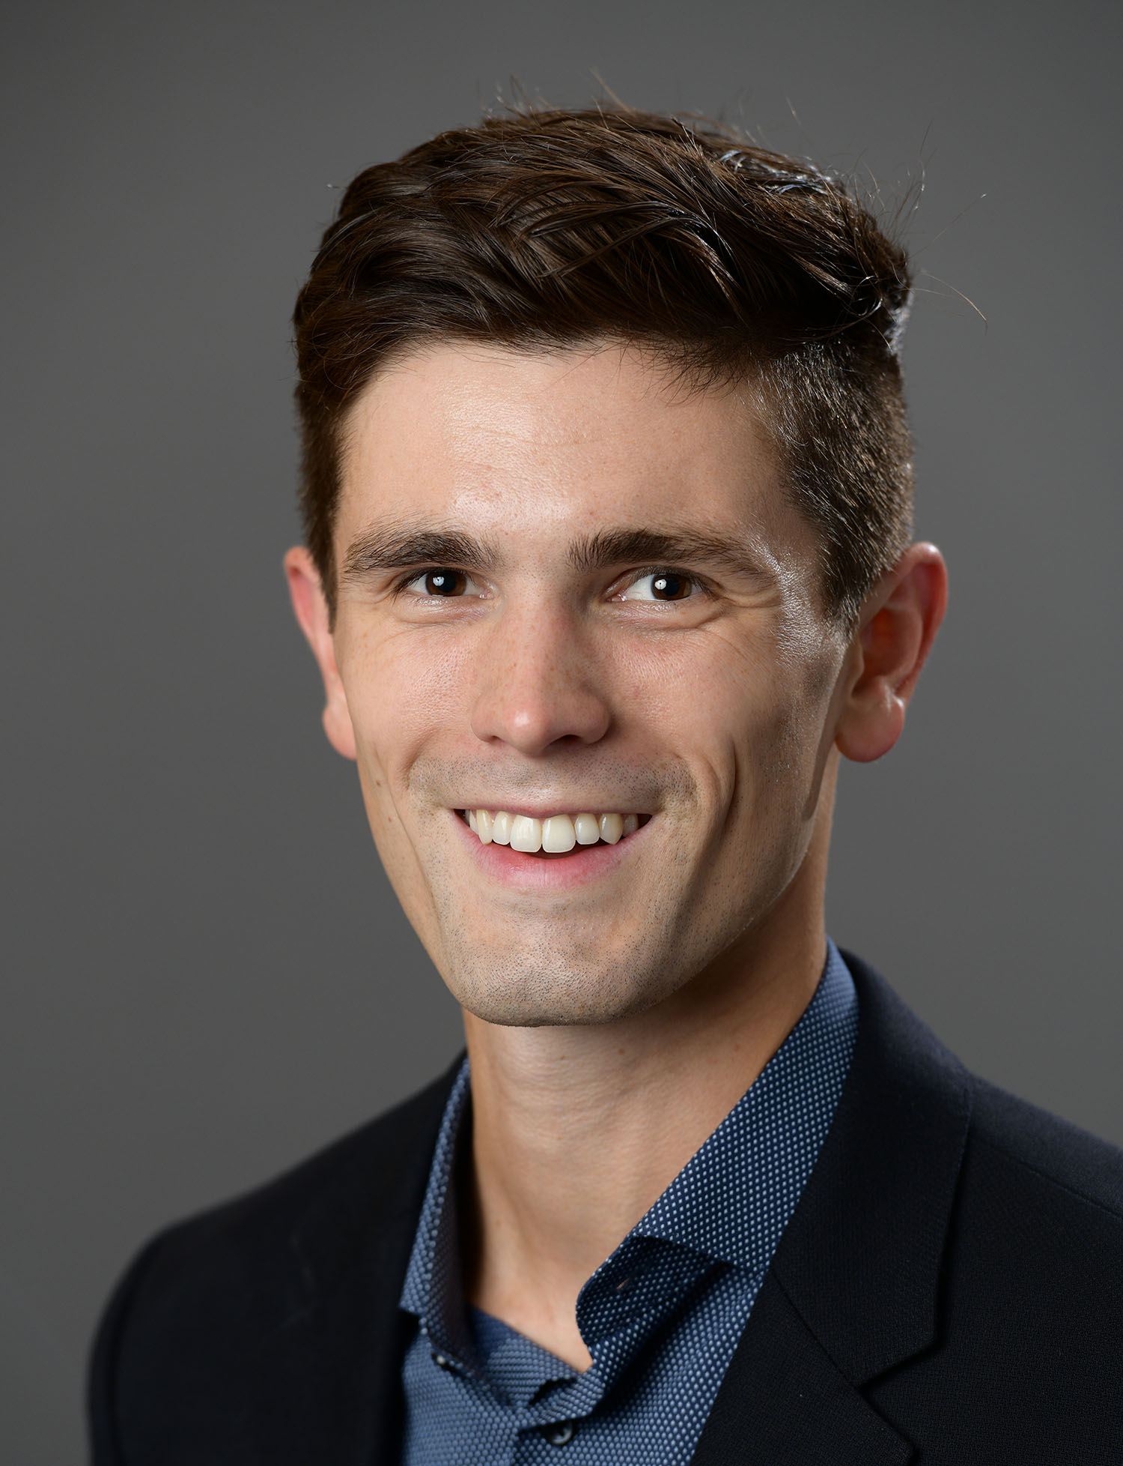
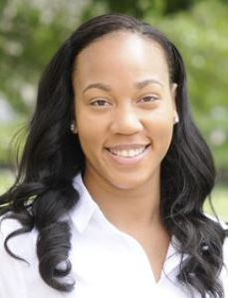
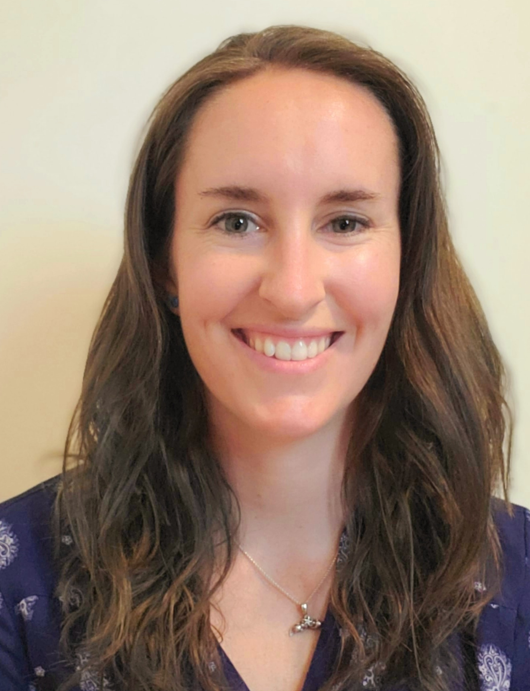
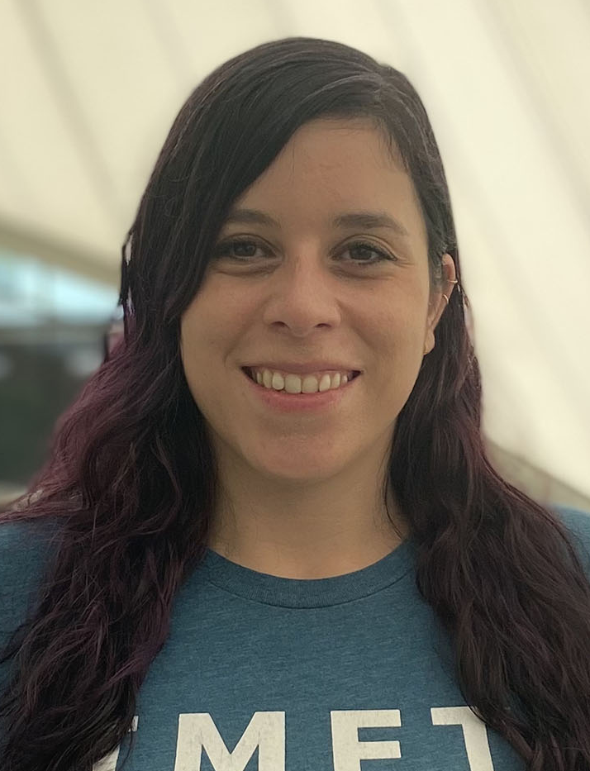
Panel discussion
Brendan Philip
The White House Executive Office of the President, Council on Environmental Quality
Nikelene Mclean
NOAA National Environmental
Satellite, Data, and Information Service
Amber Fandel
NOAA Office of
Legislative and Intergovernmental Affairs
Ana Sosa
NOAA National Sea Grant Office, NOAA Office of Education
Notes:
Iintroduce self
Office in
Memorable experience from the past year

Slide 16
Questions?
Thank you for attending!

